Slide 1
Neural Networks
Course 4: CrossEntropy & Backpropagation

Slide 2
Overview
Cross Entropy
Softmax
Backpropagation
How to adjust hyper-parameters.

Slide 3
The Problem With MSE

Slide 4


The Problem With Quadratic Cost
On the last course we have derived the update equation for a linear classifier (Adeline) when trained using gradient descent and the Mean Square Error as the cost function:
adjust w: $w=w−η\frac{dC}{dw}=w+\frac{η}{n}\sum_{x}{\left(t_{x}−y_{x}\right)x }$
adjust b: $b=b−η\frac{dC}{db}=b+\frac{η}{n}\sum_{x}{η(t_{x}−y_{x}) }$

Slide 5
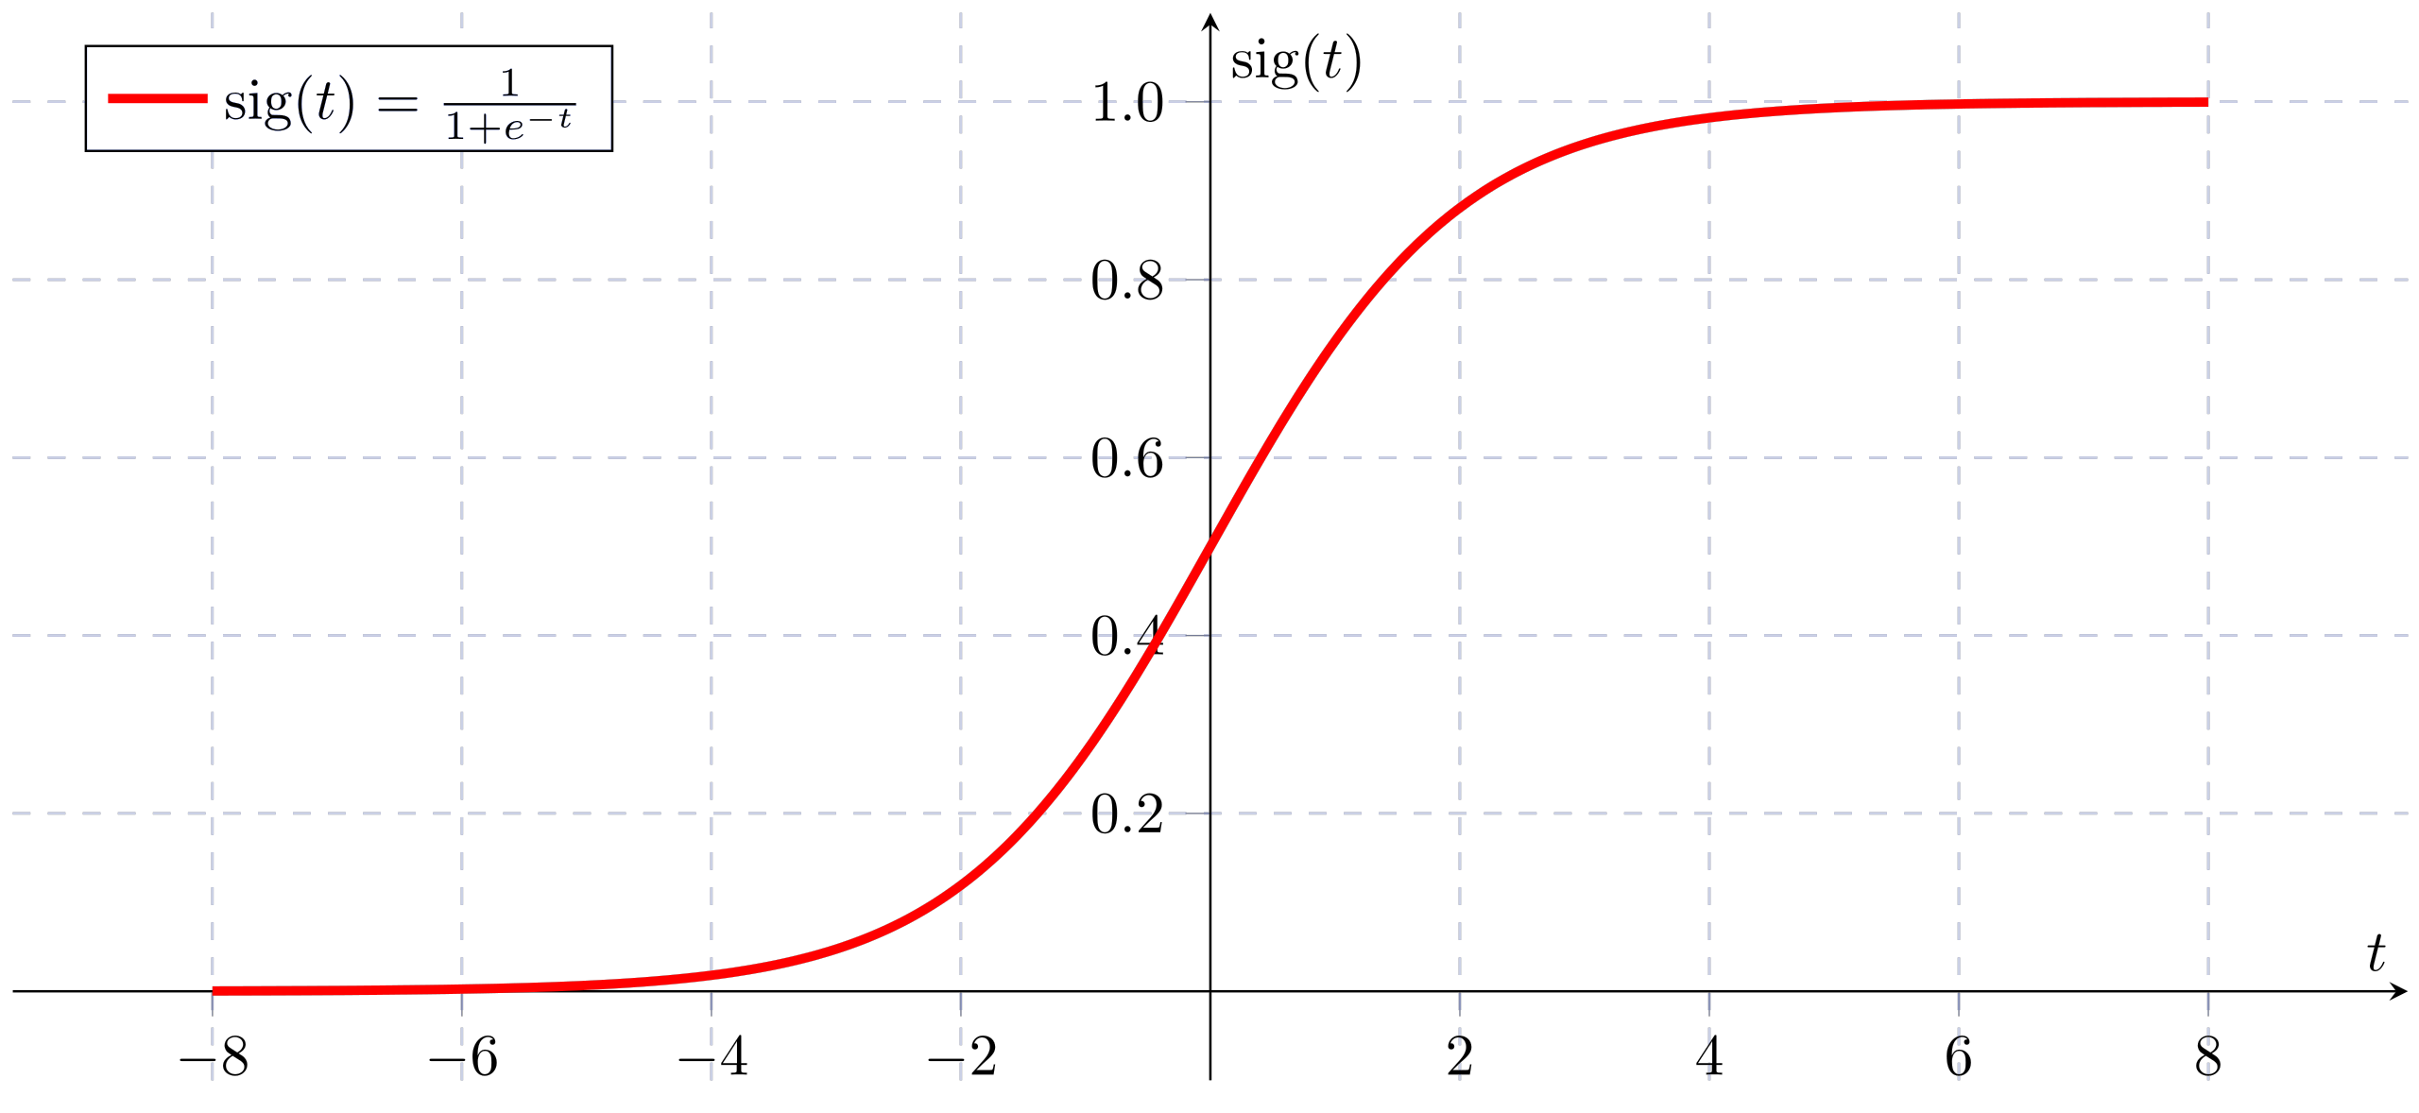
The Problem With Quadratic Cost
We have seen that a linear combination of linear classifiers is still a linear classifier. To achieve better classification accuracy, we need non-linearity
We have also introduced the sigmoid activation function which adds the necessary nonlinearity
Notes:
Remember that gradient descent performs

Slide 6
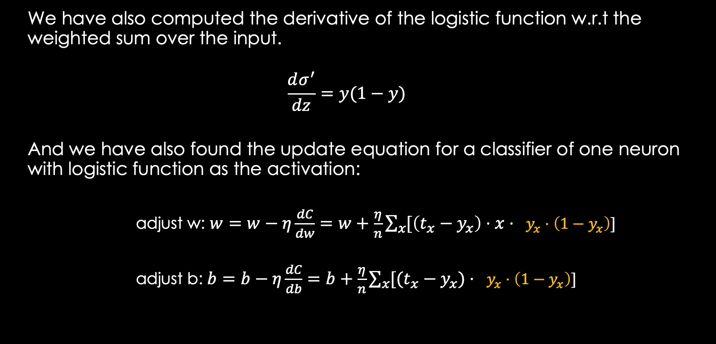
The Problem With Quadratic Cost
We have also computed the derivative of the logistic function w.r.t the weighted sum over the input.
$$\frac{dσ^{′}}{dz}=y(1−y)$$
And we have also found the update equation for a classifier of one neuron with logistic function as the activation:
adjust w: $w=w−η\frac{dC}{dw}=w+\frac{η}{n}\sum_{x}{[\left(t_{x}−y_{x}\right)⋅x⋅ }y_{x}⋅\left(1−y_{x}\right)\text{]}$
adjust b: $b=b−η\frac{dC}{db}=b+\frac{η}{n}\sum_{x}{[(t_{x}−y_{x})⋅ }y_{x}⋅\left(1−y_{x}\right)\text{]}$

Slide 7
The Problem With Quadratic Cost
An important feature that we want from a neuron (and from a neural network) is to learn fast. For this to work, the weights must be lowered in direct proportion to how big the error is.
If the error is big, then big adjustment must be made in order to drive the cost down
If the error is small, then we want to make small adjustments to not overshoot our target

Slide 8
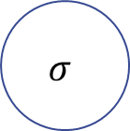
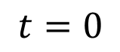
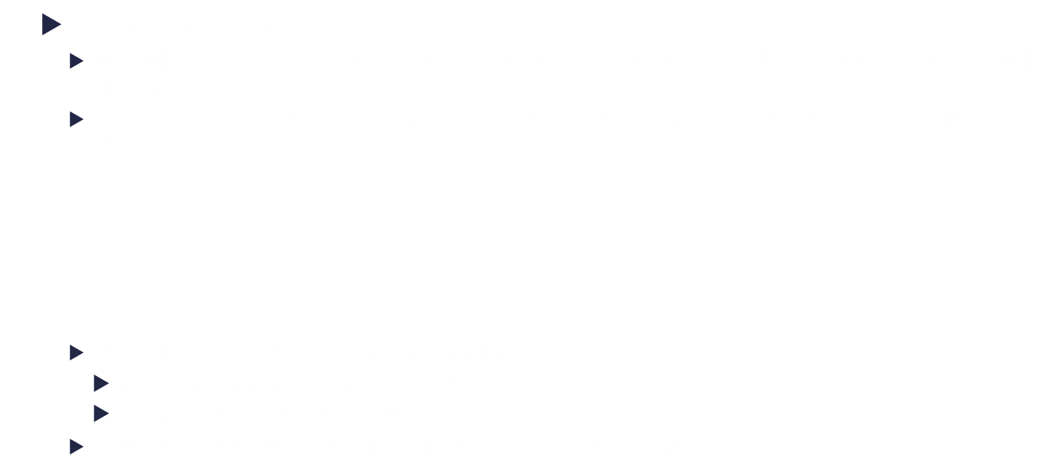


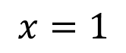
The Problem With Quadratic Cost
A small experiment.
We will take a neuron with only one input (one weight) and one bias. The input will always be 1.
The role of the neuron is to find the weights that make the output zero. So drive the 1 to zero
We will test the network in two variants:
$w=0.6 b=0.9 . z=1.5. σ\left(1.5\right)=0.81$
$w=2 b=2 . z=4. σ\left(4\right)$ = 0.98
Observe how fast the value drops to 0 for each case
$$b$$
$$w$$
$$σ$$
$$x=1$$
$$t=0$$

Slide 9
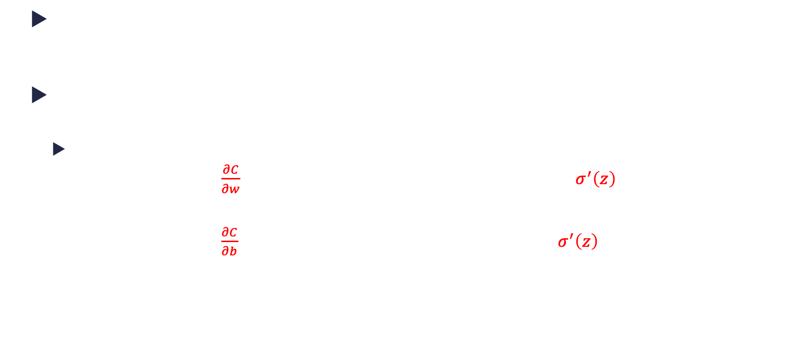
The Problem With Quadratic Cost
As it can be observed, when the error is big (second case) the learning is slower. This is the opposite as what we want.
Why is this happening?
The weight and bias are adjusted according to the formula :
$w=w−η\frac{∂C}{∂w}$ $\frac{∂C}{∂w}=\frac{∂C}{∂y}∙\frac{∂y}{∂w}=\frac{∂C}{∂y}∙\frac{∂y}{∂z}∙\frac{∂z}{∂w}=\left(y−t\right)σ^{′}\left(z\right)x=yσ^{′}\left(z\right)(for our case)$
$b=b−η\frac{∂C}{∂b}$ $\frac{∂C}{∂b}=\frac{∂C}{∂y}∙\frac{∂y}{∂b}=\frac{∂C}{∂y}∙\frac{∂y}{∂z}∙\frac{∂z}{∂b}=\left(y−t\right)σ^{′}\left(z\right)=yσ^{′}\left(z\right)(for our case)$

Slide 10
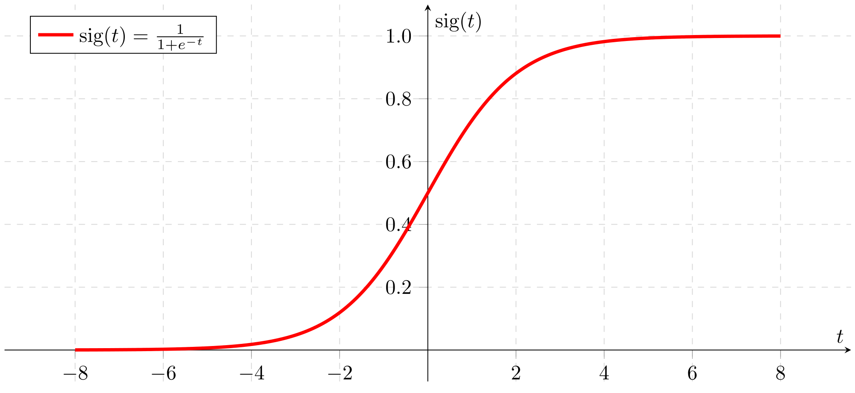
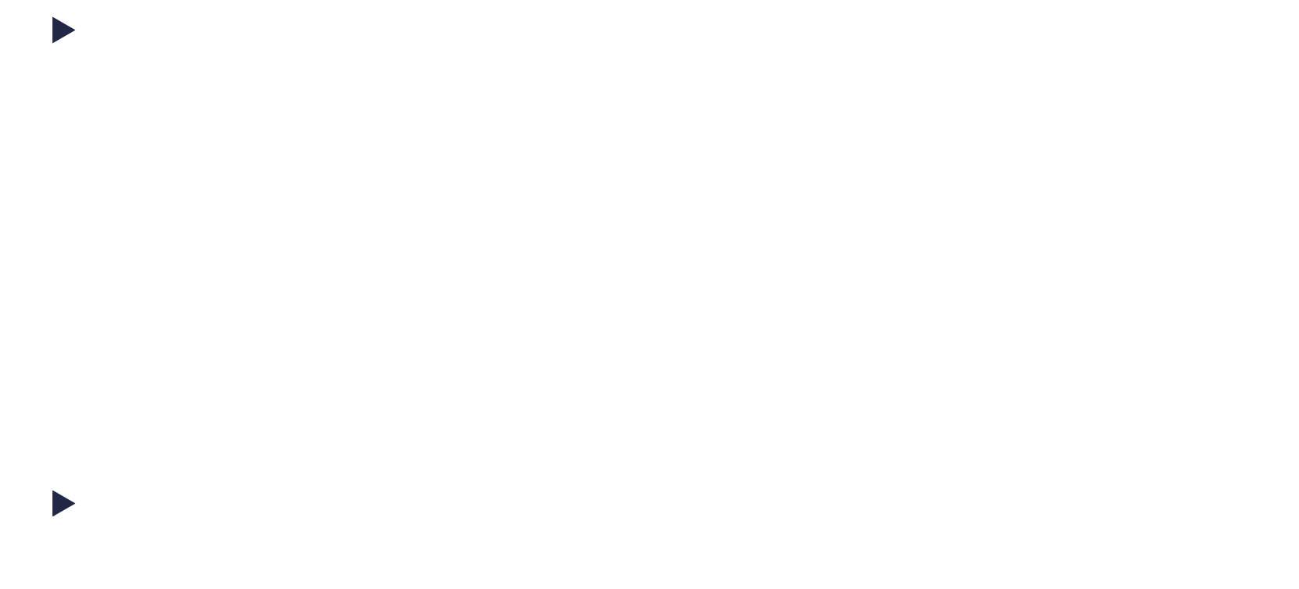

The Problem With Quadratic Cost
So, how the error changes in respect to the weight or the bias, depends on $σ′(z)$
For large values of z, the function is almost flat. So the derivate is very small. Thus, learning is slow.
$$σ^{′}\left(z\right)$$

Slide 11
Cross Entropy

Slide 12
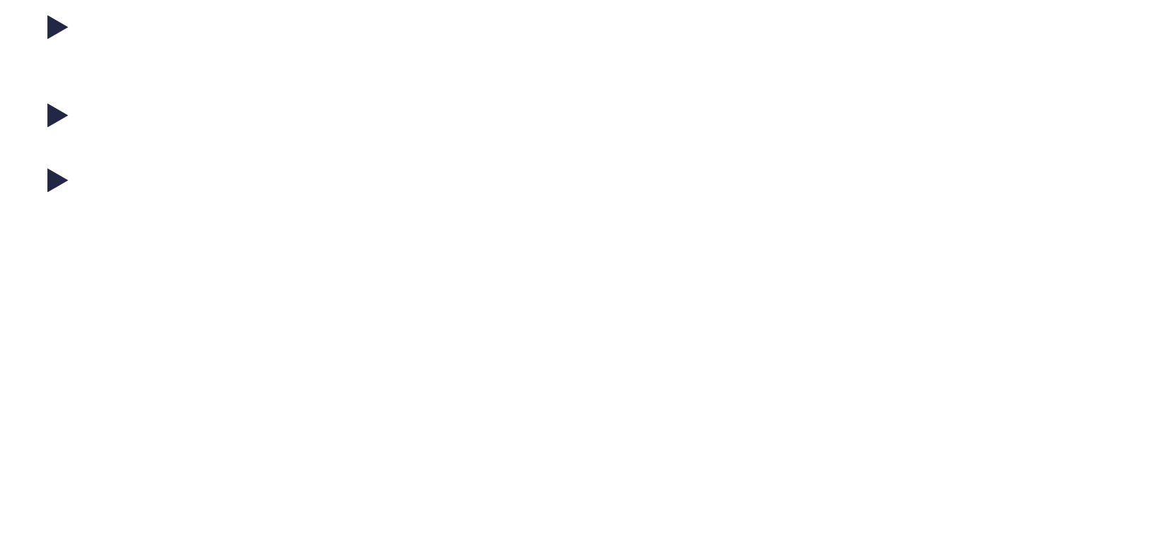
Cross Entropy
One of the way to solve the slow learning problem is to change the cost function.
We want a function that its derivate does not contain the $σ′(z)$
For a neuron with an output ($y$) and the target t the cross entropy is defined as:
$C=−\frac{1}{n}\sum_{x}{\left[tlny+\left(1−t\right)\ln\left(1−y\right)\right]}$
where:
n =number of training items
x = a training item
y = activation for item x
t = expected output for item x
The sum is over all training items.

Slide 13
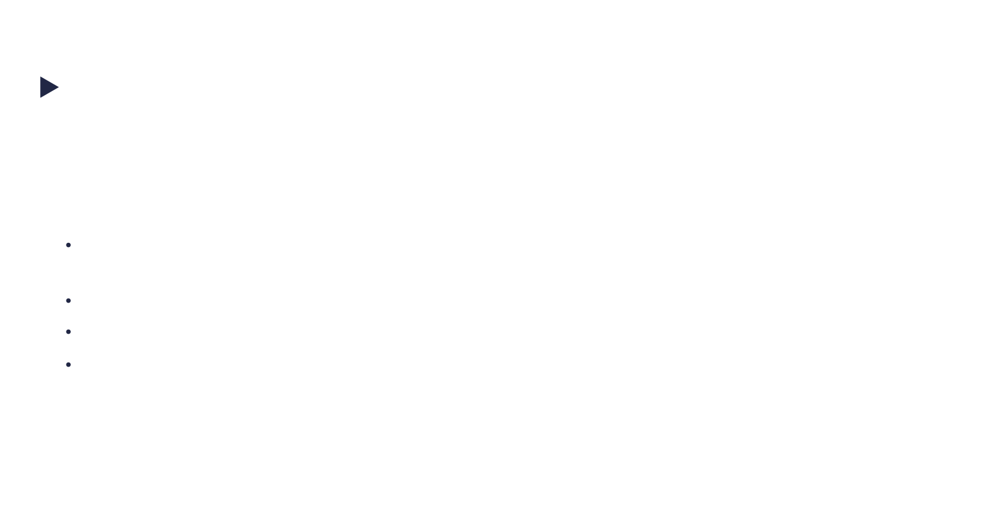
Cross Entropy
Does this function fix our problem?
$$C=−\frac{1}{n}\sum_{x}{\left[tlny+\left(1−t\right)\ln\left(1−y\right)\right]}$$
First, observe that is behaves like a cost function:
since y$∈\left[0,1\right]$ that means that $lny$ and $ln⁡(1−y)$ are negative and the output is multiplied by a negative number. So it results a positive number
When $t=0 and y≈0$, then the sum is 0 (or very close to 0)
When $t=1 and y≈1$, then the sum is 0 (or very close to 0)
When $t=1$ the function depends on ln(y). $ln$ is a monotonic function
So this seems to work like a cost function, but how do $\frac{∂C}{∂w}$ and $\frac{∂C}{∂b}$ look like?

Slide 14
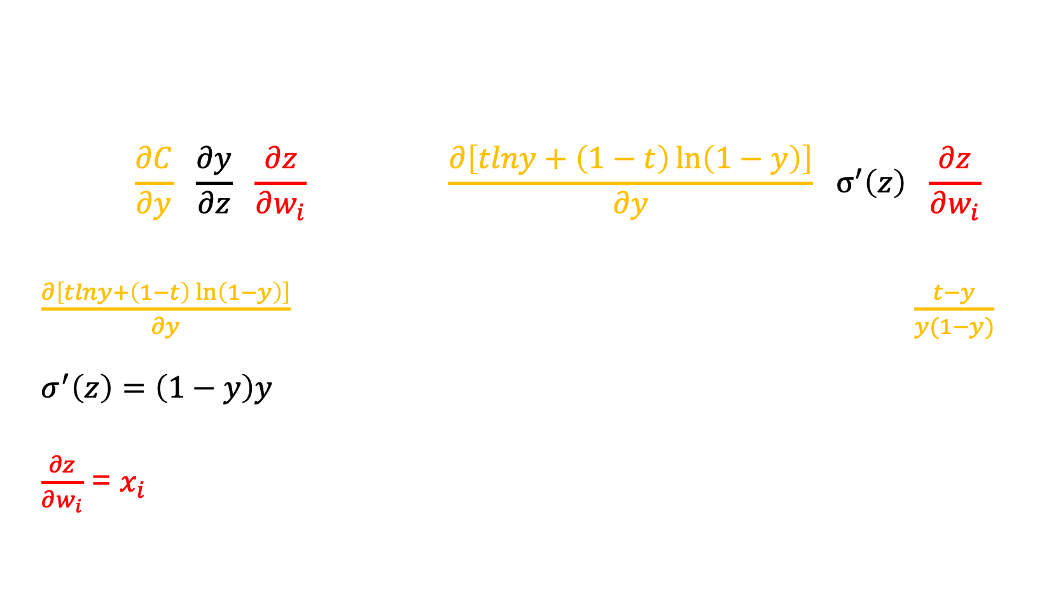
Cross Entropy
$$\frac{∂C}{∂w_{i}}=\frac{∂C}{∂y}∙\frac{∂y}{∂z}∙\frac{∂z}{∂w_{i}}=−\frac{1}{n}\sum_{x}{\frac{∂\left[tlny+\left(1−t\right)\ln\left(1−y\right)\right]}{∂y}}∙σ^{′}\left(z\right)∙\frac{∂z}{∂w_{i}}$$
$\frac{∂\left[tlny+\left(1−t\right)\ln\left(1−y\right)\right]}{∂y}=\frac{t}{y}+\frac{1−t}{1−y}∙{\left(1−y\right)}^{′}=\frac{t}{y}−\frac{1−t}{1−y}=\frac{t−ty−y+ty}{y\left(1−y\right)}=\frac{t−y}{y(1−y)}$
$$σ^{′}\left(z\right)=\left(1−y\right)y$$
$\frac{∂z}{∂w_{i}}$ = $x_{i}$
Notes:
Keep in mind that here, x is actually the output of the previous layer

Slide 15
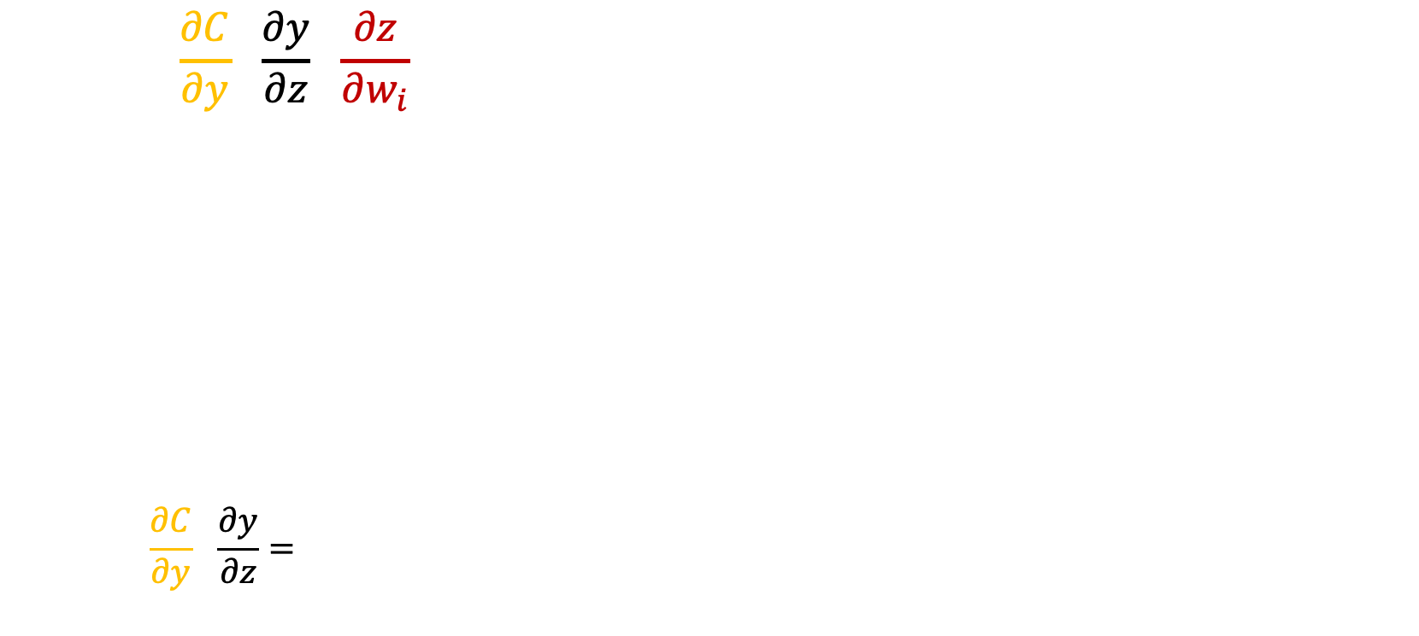
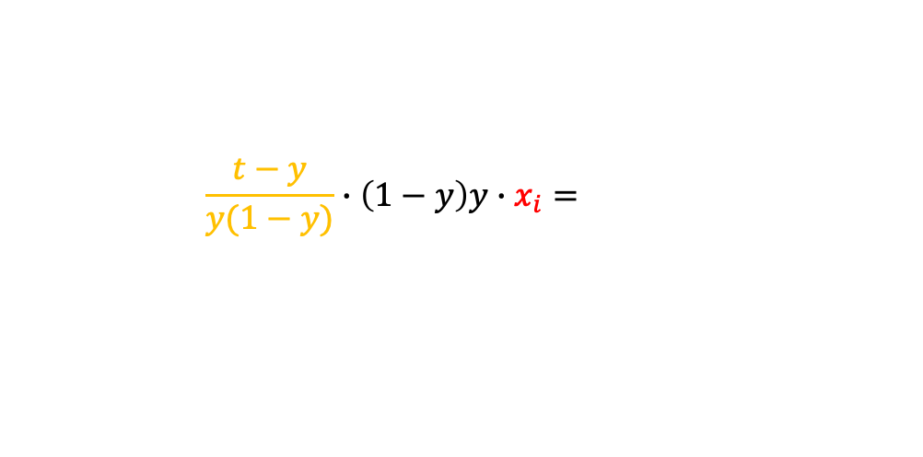


Cross Entropy
$$\frac{∂C}{∂w_{i}}=\frac{∂C}{∂y}∙\frac{∂y}{∂z}∙\frac{∂z}{∂w_{i}}=$$
(for later use)
$$\frac{∂C}{∂z_{i}}=\frac{∂C}{∂y}∙\frac{∂y}{∂z}=−(t−y)$$
$$−\frac{1}{n}\sum_{x}{\frac{t−y}{y(1−y)}}∙\left(1−y\right)y∙x_{i}=−\frac{1}{n}\sum_{x}{\left(t−y\right)x_{i}}$$
$$\frac{∂C}{∂w_{i}}=−\frac{1}{n}\sum_{x}{\left(t−y\right)x_{i}}$$
$$\frac{∂C}{∂b}=−\frac{1}{n}\sum_{x}{\left(t−y\right)}$$
Just for one sample
Notes:
Keep in mind that here, x is actually the output of the previous layer

Slide 16
Cross Entropy
We will try to repeat the previous experiment, but this time with the cross entropy function.
A thing that we must also change is the learning rate. Learning rate is dependent on the cost function. Changing the learning rate is not cheating since we are interested in how the learning speed changes but rather the slope of the learning curve.

Slide 17
(more on)Cross Entropy
Where did the function come from?! (it looks very complicated at first sight)
Cross Entropy is specifically designed for classification. The target must be either one-hot, or must be a probability distribution
The term "cross-entropy" comes from information theory. It measures the difference between two probability distributions and quantifies how well one distribution predicts or approximates another.
One hot vector for classifying digit 8
0 | 0 | 0 | 0 | 0 | 0 | 0 | 0 | 1 | 0
Soft target vector for classifying digit 8
0.05 | 0 | 0 | 0.1 | 0 | 0 | 0 | 0 | 0.85 | 0
Notes:
The entropy of a distribution P measures how many bits you need on average to encode data from P with the code that is optimal for P.
The cross-entropy of a distribution P with respect to a distribution Q measures how many bits you need on average to encode data from P with the code that is optimal for Q

Slide 18

(more on)Cross Entropy
Consider that we have a system (neural network) that has some configuration and must classify the inputs to several m classes (ex. Digits).
The probability of classifying an input to each class is $y_{j}$, where $\sum_{j}{y_{j}}=1$
Let’s suppose that for our dataset we have $k_{j}$ elements for each $j$ class. According, to the model, the likelihood of this happening is:
$P\left(data\right|model)= y_{1}^{k_{1}}y_{2}^{k_{2}}…y_{m}^{k_{m}}$
Notes:
Aici vorbim despre verosimilitate (likelihood)
Fiecre element din baza de date are clasa lui corecta, care ar trebui sa fie y_i. Probabilitatea sa nimeresc clasa corecta este y1 pentru acel element... Mai vine unul, probabilitatea este tot y1... Practic, probabiltiatea sa nimeresc clasele corecte, date modelul sunt y1 * y1 * y1 ... * y2 * y2 * ...
Vream sa crestem aceasta probablitatea.

Slide 19
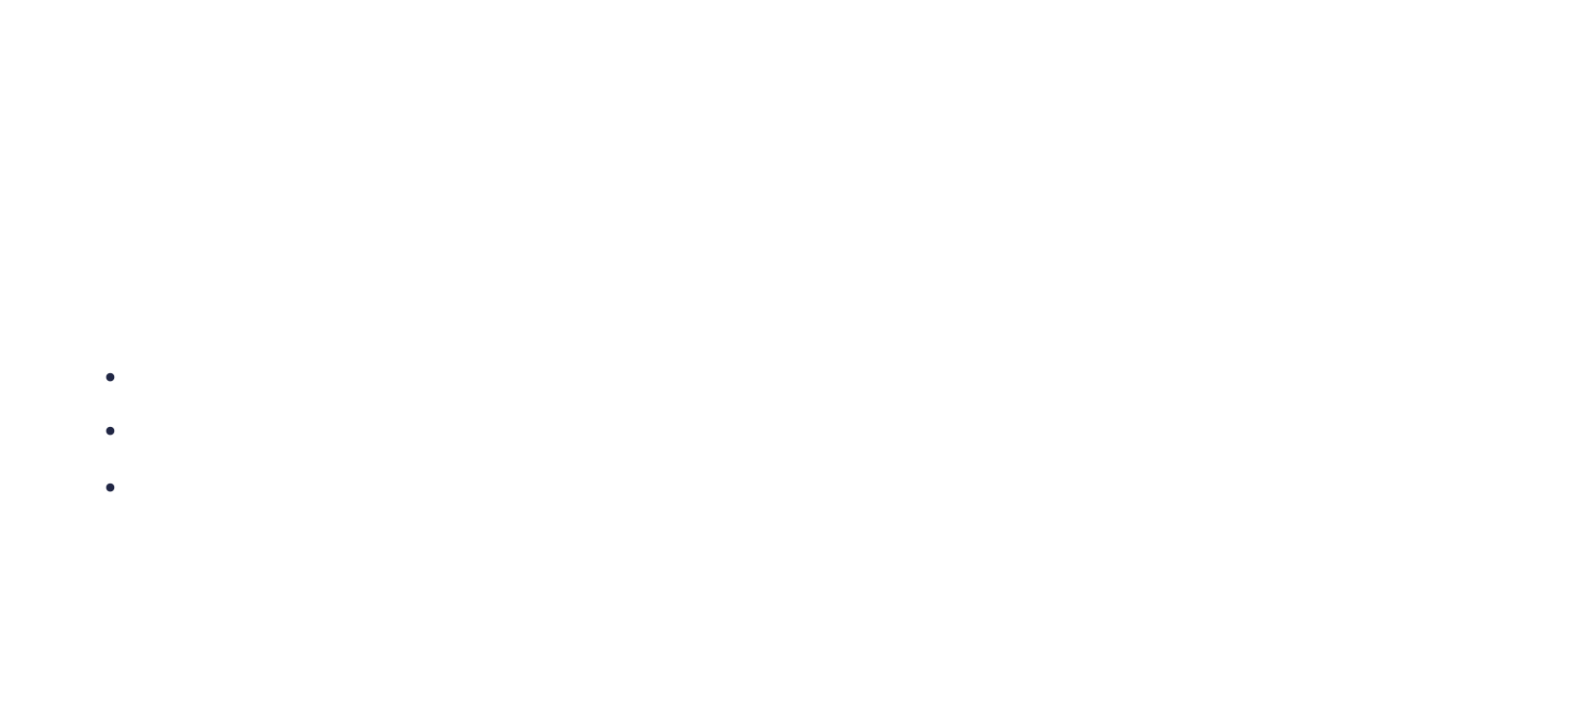
(more on)Cross Entropy
If we apply the logarithm function, then
$ln(P\left(data\right|model))=ln⁡(y_{1}^{k_{1}}y_{2}^{k_{2}}…y_{m}^{k_{m}})=ln⁡(y_{1}^{k_{1}})+ln⁡(y_{2}^{k_{2}})+…+ln⁡(y_{m}^{k_{m}})=$
$=\sum_{j}{k_{j}ln⁡(y_{j}})$
Using the logarithm function, we have some advantages:
It’s a monotonic function.
Transforms the product into a sum
Logarithm of a very small number is a negative number
Notes:
This means that maximizing the logarithm of the target function is equivalent to maximizing the function
Transformarea in suma e utila mai ales atunci cand avem produs de numere mici. Acestea pot devein si mai mici si nu mai incap in repreentare
Logarithm of a very small number is a negative number: greu de reprezentat numere reale mici

Slide 20

(more on)Cross Entropy
Obviously, we want to increase this probability, but since we’re used to minimizing a cost function, we’ll minimize the same function but with the opposite sign (-)
If we divide by the number of elements in the dataset (n), then $\frac{k_{j}}{n}$ becomes the true probability of the elements of each class.
C$ross Entropy: −\sum_{j}{t_{j}}\ln\left(y_{j}\right)$
Notes:
Entropia masoara gradul de surpriza.. E invers cu probabiitatea ca un eveniment sa se intample, dar masurat cu logartim-ul, fiind o functie monotona.
De asemena, logaritmul da si posibilittea sa aduni supriza a doua evenimente
The entropy of a distribution P measures how many bits you need on average to encode data from P with the code that is optimal for P.
The cross-entropy of a distribution P with respect to a distribution Q measures how many bits you need on average to encode data from P with the code that is optimal for Q

Slide 21

(more on)Cross Entropy
Similarity with Entropy :
$Entropy: −\sum_{j}{t_{j}}\ln\left(t_{j}\right)$
Entropy measures the average uncertainty (or surprise) in the true probability distribution.
In other words: “How surprised would you be, on average, if you drew events according to their true probabilities?”
C$ross Entropy: −\sum_{j}{t_{j}}\ln\left(y_{j}\right)$
Cross-entropy measures the average surprise when events actually come from the true distribution, but you believe they will come based on another distribution (usually your model’s predictions).
Notes:
Entropia masoara gradul de surpriza.. E invers cu probabiitatea ca un eveniment sa se intample, dar masurat cu logartim-ul, fiind o functie monotona.
De asemena, logaritmul da si posibilittea sa aduni supriza a doua evenimente
The entropy of a distribution P measures how many bits you need on average to encode data from P with the code that is optimal for P.
The cross-entropy of a distribution P with respect to a distribution Q measures how many bits you need on average to encode data from P with the code that is optimal for Q

Slide 22


(more on)Cross Entropy
We can obtain an estimation by averaging this metric across the entire dataset.
Where i is the index of a sample, j is the index class, n is the number of samples and m is the number of classes
If the number of classes is just 2, the above formula becomes:
$$C=−\frac{1}{n}\sum_{i}^{n}{\sum_{j}^{m}{t_{ij}ln⁡(y_{ij})}}$$
$$C=−\frac{1}{n}\sum_{i}^{n}{t_{i}\ln\left(y_{i}\right)}+\left(1−t_{i}\right)ln⁡(1−y_{i})$$

Slide 23

(more on)Cross Entropy
If the target vector is one hot encoding, then the Cross Entropy formula for one sample becomes
$$C=−ln⁡(y_{j})$$
Of course, this is still the cross entropy, but in a more simplified version that takes account for the fact that $t_{j}$=1 for the right label and 0 for the rest. (one hot)
Notes:
Entropia masoara incertitudinea dintr-un sistem. (sau gradul de informatie pe care-l am despre sistem)
Un sistem poate fi in mai multe stari. Cand probabiltiatea pentru orice stare este egala, atunci entropia este mare. Cand stiu raspunsul, entropia este mica
In cazul in care avem o moneda si fiecare fata are probabiltiate egala, 0.5, atunci voi spune ca entropia este maxima (pentru sistemul respectiv).
Cand probabiltiatea unei fete este mai mare, adica pot aproxima mai bine ce fata va cadea, atunci entropia este mai mica.
Deci cand pot anticipa rezutlatul, entropie mica, cand nu pot, entropie mare
Seamana foarte mult cu formula pentru entropie –sum(p(x)log(p(x))
http://web.mit.edu/16.unified/www/FALL/thermodynamics/notes/node56.html
Ideea din spatele formulei e simpla. Trebuie o formula care sa-mi spuna cat de random e un sistem, bazat doar pe probabilitatile microelementelor din system.
Media unei functii f, pe toate microstarile este
$\sum_{i}{p_{i}f(p_{i})}$, unde f treubie sa o aflame
Ca f sa respecte conditia ca f(a)+f(b)=f(a+b), alegem ln
mai alegem si o cosntanta astfel incat entropia sa fie pozitiva

Slide 24
Softmax

Slide 25
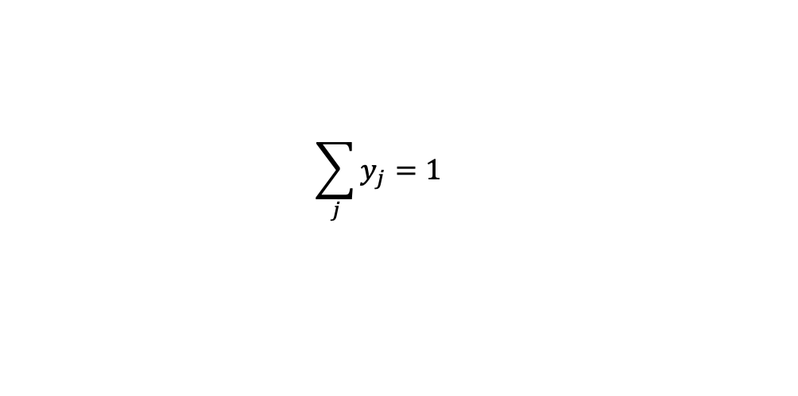





Softmax
When we’ve talked about Cross Entropy we have assumed that the output of the model is a distribution
This is true for binary classification, when using sigmoid activation, since we’re considering one class to be
$y_{1}= σ(z$) and the other $y_{2}=1−σ\left(z\right)$
Input $x_{i}$
output ${σ(z)}_{}$
$$\sum_{j}{y_{j}}=1$$
Class1 = ${y_{1}=σ(z)}_{}$
Class2 = ${y_{2}=1−σ(z)}_{}$
Notes:
De ce avem nevoie de probabiltiati? Ce avantaje au (pai o probabiltiate mare la o cifra, autoamt scade probabiltiatea la restul)
E ok functia respectiva? Pentru probabiltiati?

Slide 26




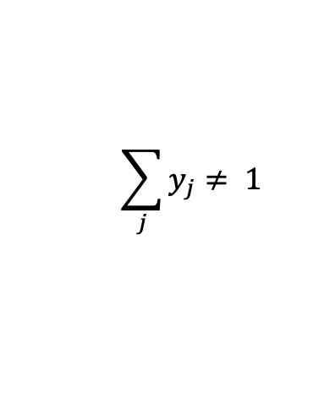


Softmax
When we’ve talked about Cross Entropy we have assumed that the output of the model is a distribution
However, when performing multi class classification and using linear or sigmoid activation, we do not have this guarantee.
For Cross Entropy to work efficiently, we need to convert the output layer to a distribution
$$y_{1}$$
$$y_{2}$$
$$\sum_{j}{y_{j}}≠ 1$$
$$y_{3}$$
$$y_{4}$$
Input $x_{i}$
output $y_{j}$
Notes:
De ce avem nevoie de probabiltiati? Ce avantaje au (pai o probabiltiate mare la o cifra, autoamt scade probabiltiatea la restul)
E ok functia respectiva? Pentru probabiltiati?

Slide 27

Softmax
For this, we introduce the softmax activation function.
Softmax will only be used in the final layer of the neural network
For z = [z₁,z₂,..z_{m}] a vector we can normalize it in the following way:
$$softmax\left(z\right)=\left[y_{1}, y_{2},…y_{m}\right], with y_{i}= \frac{e^{z_{i}}}{\sum_{j=1}^{m}{e^{z_{j}}}}, i⊂[1..m]$$
Notes:
De ce avem nevoie de probabiltiati? Ce avantaje au (pai o probabiltiate mare la o cifra, autoamt scade probabiltiatea la restul)
E ok functia respectiva? Pentru probabiltiati?

Slide 28


Softmax
Observations:
1. Each $\frac{e^{z_{i}}}{\sum_{j=1}^{m}{e^{z_{j}}}}$is a positive value with values in interval[0, 1]
2. The sum of all the outputs in the final layer is 1
3. Due to the use of exponential, the difference between values is amplified.
$$\sum_{i=1}^{m}{y_{i}=}\sum_{i=1}^{m}{\left(\frac{e^{z_{i}}}{\sum_{j=1}^{n}{e^{z_{j}}}}\right)}=1$$

Slide 29


Activation functions
Example:
Let z = [1,3,4,2] We first compute the exponents:
e¹ ~= 2.71
e³ ~= 20.08
e⁴ ~= 54.59
e² ~= 7.38
Then:
$softmax\left(z\right)=\left[\frac{e^{1}}{sum},\frac{e^{3}}{sum},\frac{e^{4}}{sum},\frac{e^{2}}{sum}\right]=\left[\frac{2.71}{84.75},\frac{20.08}{84.75},\frac{54.49}{84.75},\frac{27.38}{84.75}\right]$= $\left[0.03, 0.24, 0.64, 0.09 \right]$
$$sum= \sum_{j=1}^{4}{e^{z_{j}}}=2.71+20.08+54.59+7.38=84.75$$

Slide 30
Activation functions
Example:
So , for z = [1,3,4,2], softmax(v) = [0.03, 0.24, 0.64, 0.09]
We can also see softmax(z) as [3%, 24%, 64%, 9%].
This allows us to see what is most important element in the vector (the 3rd).
Observe that the difference between 3 and 4 is amplified from 4/3 (from 33% ) to 0.64/0.24 (166%)

Slide 31

Activation functions
Practical observation: for v = [z₁,z₂,..z_{m}] a vector:
$softmax\left(z\right)=\left[y_{1}, y_{2},…y_{m}\right], with y_{i}= \frac{e^{z_{i}}}{\sum_{j=1}^{m}{e^{z_{j}}}}, i⊂[1..m]$
What happens if one or multiple elements in the vector are too large ? (for example: z = [1,2,3,1000000]. The problem here is that computing e¹⁰⁰⁰⁰⁰⁰ will not scale in 64/128 bits. As such we need to normalize the formula for $y_{i}$ in the following way:
$$y_{i}= \frac{\frac{e^{z_{i}}}{k}}{\sum_{j=1}^{n}{\frac{e^{z_{j}}}{k}}}, i⊂\left[1..m\right], with k a large numerical constant,$$
$often k=\max_{i}{e^{z_{i}}}$

Slide 32
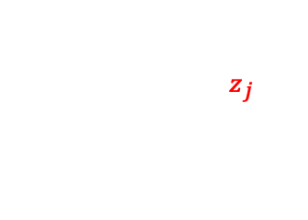

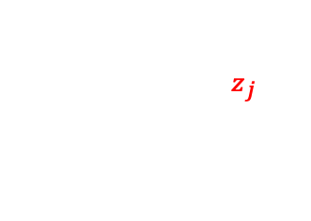
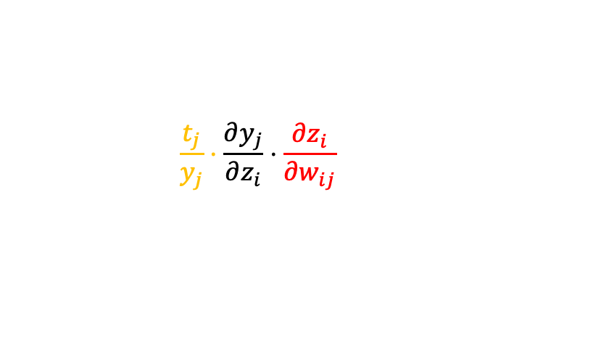

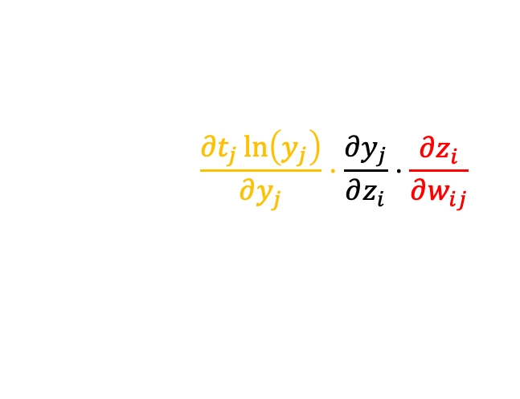
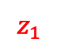

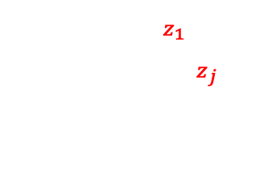

Softmax
How does the gradient look like when using Categorical CrossEntropy and Softmax?
$$\frac{∂C}{∂w_{ij}}=−\frac{∂\sum_{j}^{m}{t_{j}ln⁡(y_{j})}}{∂w_{ij}}=\sum_{j}^{m}{\left(\frac{{∂t}_{j}\ln\left(y_{j}\right)}{∂w_{ij}}\right)}$$
$$z_{1}$$
$$y_{1}=\frac{e^{z_{1}}}{\sum_{j=1}^{4}{e^{z_{j}}}}$$
$$\frac{∂C}{∂w_{ij}}=−\sum_{j}^{m}{\left(\frac{{∂t}_{j}\ln\left(y_{j}\right)}{∂y_{j}}⋅\frac{∂y_{j}}{∂z_{i}}⋅\frac{∂z_{i}}{∂w_{ij}}\right)}$$
$$y_{1}=\frac{e^{z_{2}}}{\sum_{j=1}^{4}{e^{z_{j}}}}$$
$$w_{ij}$$
$$\sum_{j}^{m}{t_{j}ln⁡(y_{j})}$$
$$y_{1}=\frac{e^{z_{3}}}{\sum_{j=1}^{4}{e^{z_{j}}}}$$
$$\frac{∂C}{∂w_{ij}}=−\sum_{j}^{m}{\left(\frac{t_{j}}{y_{j}}⋅\frac{∂y_{j}}{∂z_{i}}⋅\frac{∂z_{i}}{∂w_{ij}}\right)}$$
$$y_{1}=\frac{e^{z_{4}}}{\sum_{j=1}^{4}{e^{z_{j}}}}$$
Notes:
Se vede din graphic ca avem 2 cazuri:
Unul cand i=j, si restul cand i!=j

Slide 33
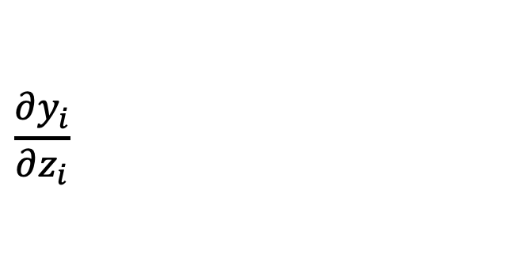
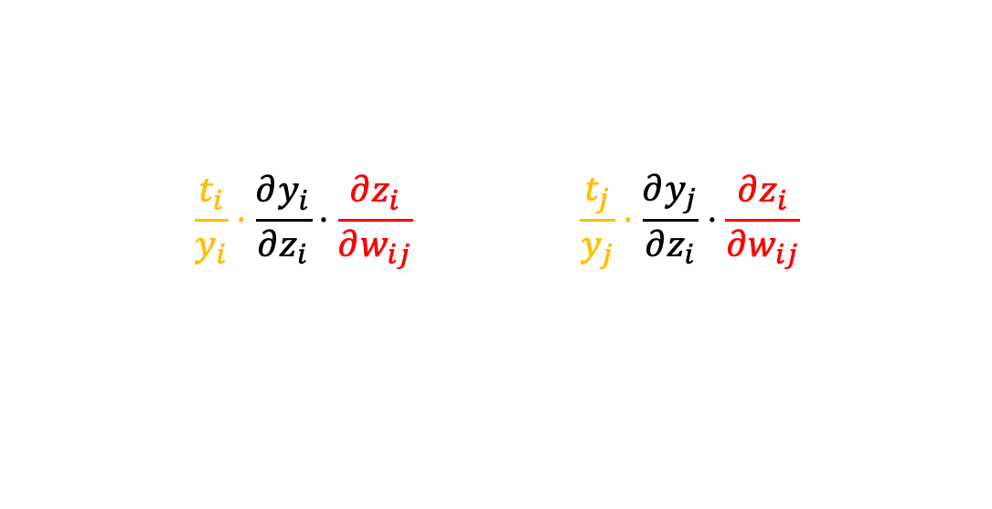
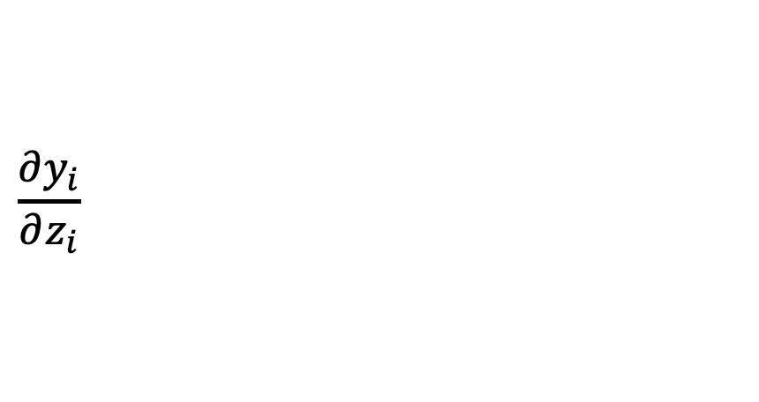
Softmax
$\frac{∂y_{j}}{∂z_{i}}$ has different gradients depending if $y_{j}=z_{i}$ or not
$$\frac{∂C}{∂w_{ij}}=−\left(\frac{t_{i}}{y_{i}}⋅\frac{∂y_{i}}{∂z_{i}}⋅\frac{∂z_{i}}{∂w_{ij}}\right) −\sum_{j, j≠i}^{m}{\left(\frac{t_{j}}{y_{j}}⋅\frac{∂y_{j}}{∂z_{i}}⋅\frac{∂z_{i}}{∂w_{ij}}\right)}$$
Case 1: $j=i$
$$\frac{∂y_{i}}{∂z_{i}}=\frac{∂Softmax}{∂z_{i}}=\frac{∂\frac{e^{z_{i}}}{\sum_{k}{e^{z_{k}} }}}{∂z_{i}}$$
$$\frac{∂y_{i}}{∂z_{i}}=\frac{\frac{∂e^{z_{i}}}{∂z_{i}}\sum_{k}{e^{z_{k}}−e^{z_{i}}\frac{∂\sum_{k}{e^{z_{k}}}}{∂z_{i}}}}{({\sum_{k}{e^{z_{k}})}}^{2}}$$

Slide 34
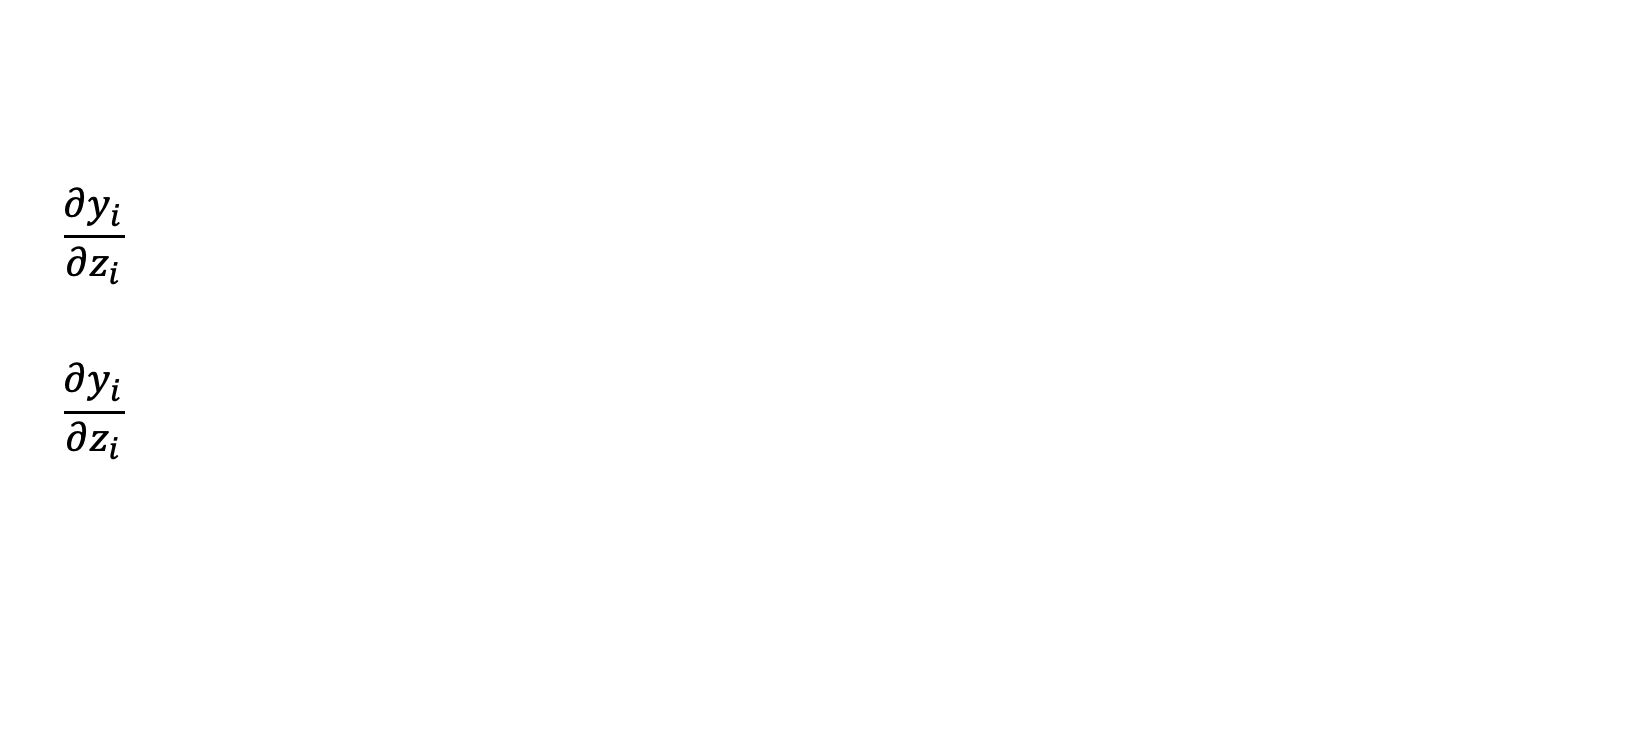
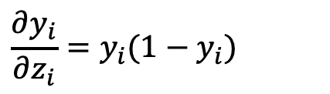
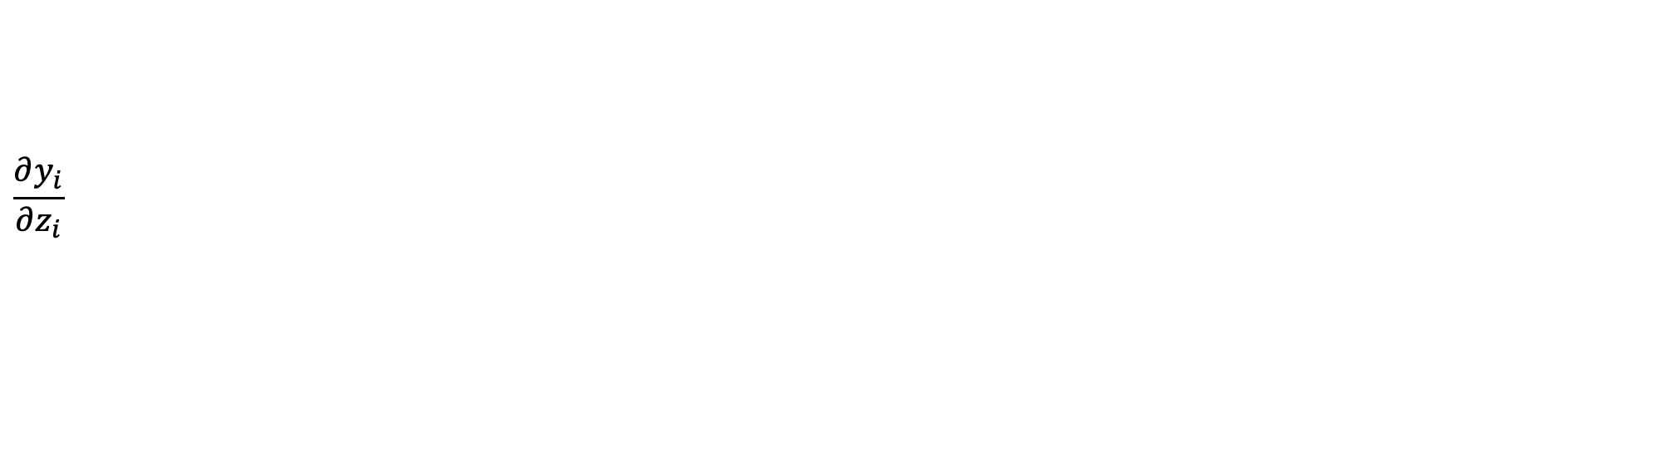
Softmax
$$\frac{∂y_{i}}{∂z_{i}}=\frac{1}{({\sum_{k}{e^{z_{k}})}}^{2}} \left(\frac{∂e^{z_{i}}}{∂z_{i}}\sum_{k}{e^{z_{k}}−e^{z_{i}}\frac{∂\sum_{k}{e^{z_{k}}}}{∂z_{i}}}\right)=$$
$$\frac{∂y_{i}}{∂z_{i}}=\frac{1}{({\sum_{k}{e^{z_{k}})}}^{2}} \left(e^{z_{i}}\sum_{k}{e^{z_{k}}−e^{z_{i}}e^{z_{i}}}\right)=$$
$$\frac{∂y_{i}}{∂z_{i}}=\frac{e^{z_{i}}\sum_{k}{e^{z_{k}}}}{({\sum_{k}{e^{z_{k}})}}^{2}}−\frac{e^{z_{i}}e^{z_{i}}}{{\sum_{k}{e^{z_{k}}}}^{2}}=\frac{e^{z_{i}}}{\sum_{k}{e^{z_{k}}}}−{\left(\frac{e^{z_{i}}}{\sum_{k}{e^{z_{k}}}}\right)}^{2}=y_{i}−{y_{i}}^{2}=y_{i}(1−y_{i})$$
$$\frac{∂y_{i}}{∂z_{i}}=y_{i}(1−y_{i})$$
If $j=i$, then

Slide 35
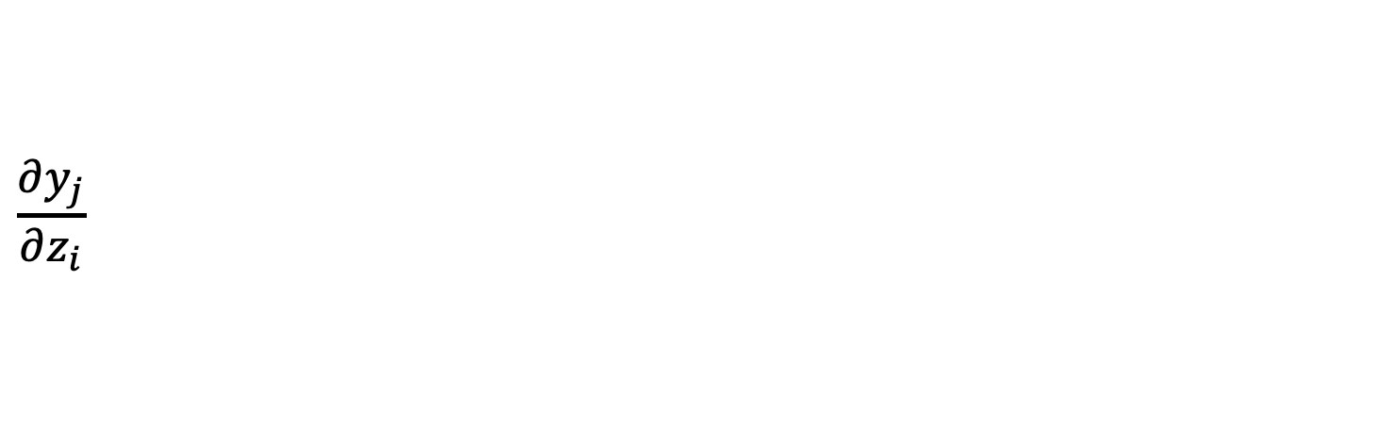
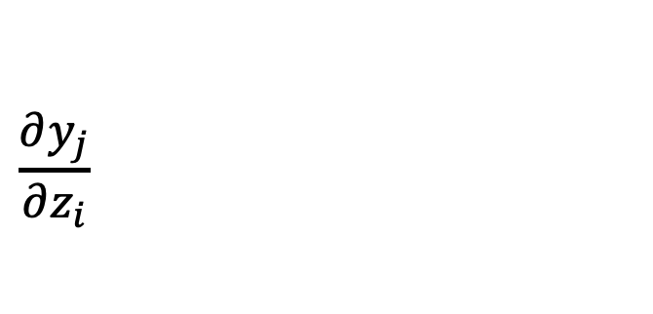
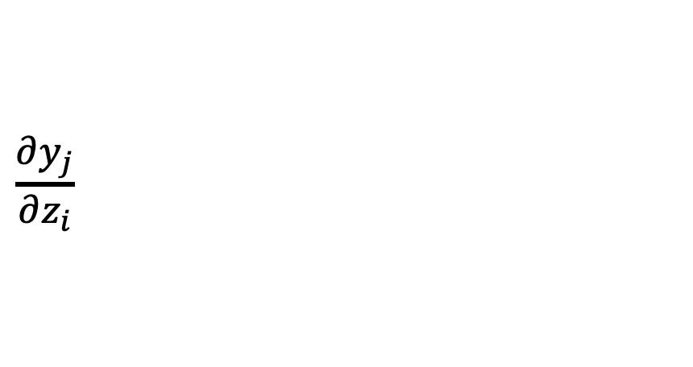
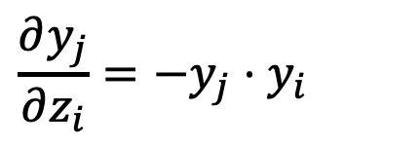
Softmax
Case 2: $j≠i$
$$\frac{∂y_{j}}{∂z_{i}}=\frac{∂Softmax}{∂z_{i}}=\frac{∂\frac{e^{z_{j}}}{\sum_{k}{e^{z_{k}} }}}{∂z_{i}}$$
$$\frac{∂y_{j}}{∂z_{i}}=\frac{\frac{∂e^{z_{j}}}{∂z_{i}}\sum_{k}{e^{z_{k}}−e^{z_{j}}\frac{∂\sum_{k}{e^{z_{k}}}}{∂z_{i}}}}{({\sum_{k}{e^{z_{k}})}}^{2}}$$
$$\frac{∂y_{j}}{∂z_{i}}=\frac{0 −e^{z_{j}}\frac{∂\sum_{k}{e^{z_{k}}}}{∂z_{i}}}{({\sum_{k}{e^{z_{k}})}}^{2}}=\frac{−e^{z_{j}}}{\sum_{k}{e^{z_{k}}}}⋅\frac{e^{z_{i}}}{\sum_{k}{e^{z_{k}}} }=−y_{j}⋅y_{i}$$
$$\frac{∂y_{j}}{∂z_{i}}=−y_{j}⋅y_{i}$$
If $j≠i$, then
Notes:
De ce avem nevoie de probabiltiati? Ce avantaje au (pai o probabiltiate mare la o cifra, autoamt scade probabiltiatea la restul)
E ok functia respectiva? Pentru probabiltiati?

Slide 36
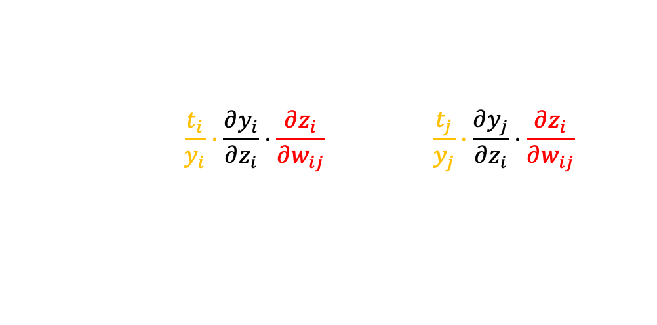
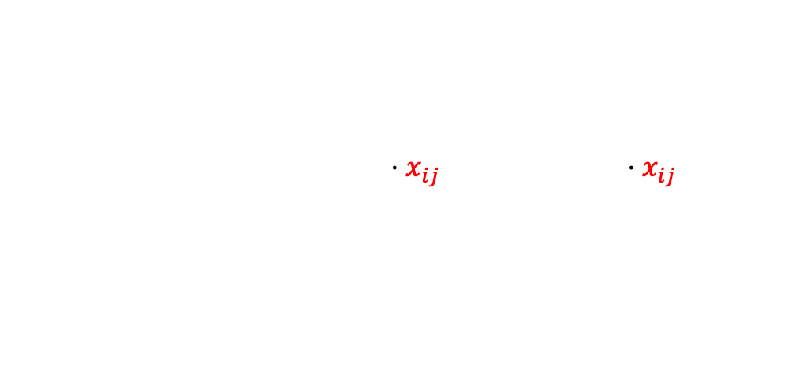
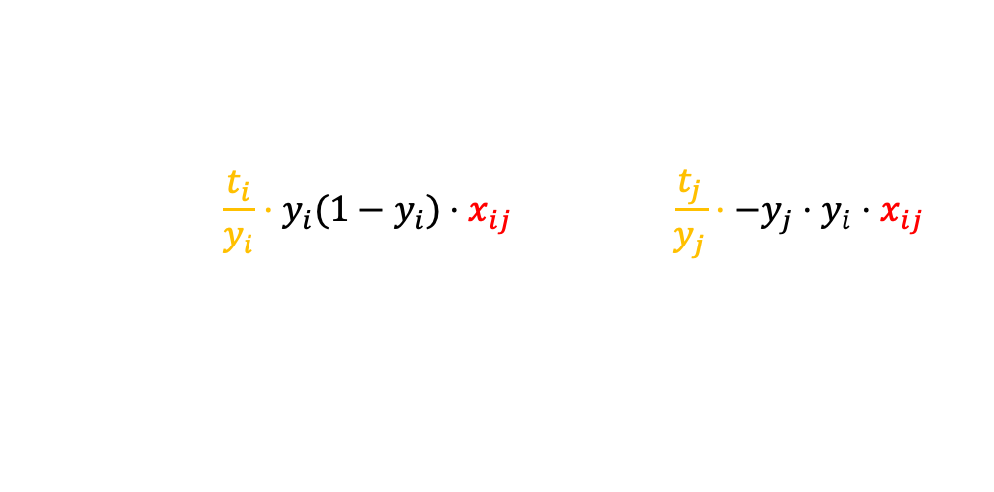
Softmax
How does the gradient look like when using Categorical CrossEntropy and Softmax?
$$\frac{∂C}{∂w_{ij}}=−\left(\frac{t_{i}}{y_{i}}⋅\frac{∂y_{i}}{∂z_{i}}⋅\frac{∂z_{i}}{∂w_{ij}}\right) −\sum_{j, j≠i}^{m}{\left(\frac{t_{j}}{y_{j}}⋅\frac{∂y_{j}}{∂z_{i}}⋅\frac{∂z_{i}}{∂w_{ij}}\right)}$$
$$\frac{∂C}{∂w_{ij}}=−\left(\frac{t_{i}}{y_{i}}⋅y_{i}(1−y_{i})⋅x_{ij}\right) −\sum_{j, j≠i}^{m}{\left(\frac{t_{j}}{y_{j}}⋅−y_{j}⋅y_{i}⋅x_{ij}\right)}$$
$$\frac{∂C}{∂w_{ij}}=−\left(t_{i}⋅ \left(1−y_{i}\right)⋅x_{ij}\right)+\sum_{j, j≠i}^{m}{\left(t_{j}⋅y_{i}⋅x_{ij}\right)}$$

Slide 37

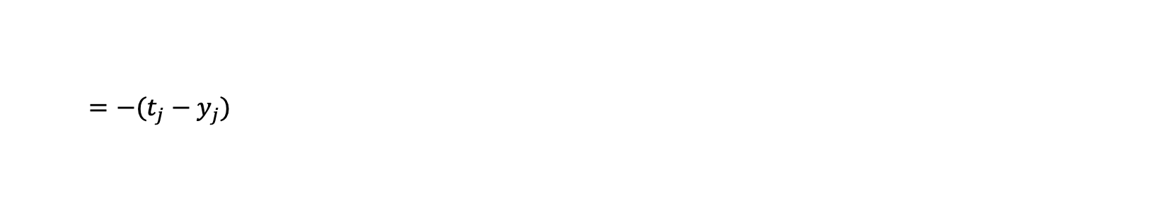
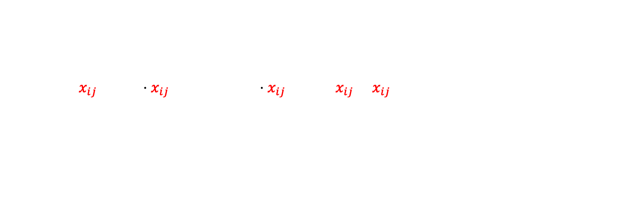
Softmax
How does the gradient look like when using Categorical CrossEntropy and Softmax?
$$\frac{∂C}{∂w_{ij}}=−t_{i}x_{ij}+t_{i}y_{i}⋅x_{ij}+\sum_{j, j≠i}^{m}{\left(t_{j}⋅y_{i}⋅x_{ij}\right)}=−t_{i}x_{ij}+x_{ij}y_{i}\sum_{j }^{m}{t_{j}}$$
$$\frac{∂C}{∂w_{ij}}=−(t_{i}−y_{i})x_{ij}$$
(for later use)
$$\frac{∂C}{∂z_{j}}=−(t_{j}−y_{j})$$
Obseration: the update rule is the same for CrossEntropy + sigmoid and CrossEntropy+Softmax
Just for one sample
Notes:
$$\sum_{j }^{m}{t_{j}}=1$$

Slide 38
Backpropagation

Slide 39


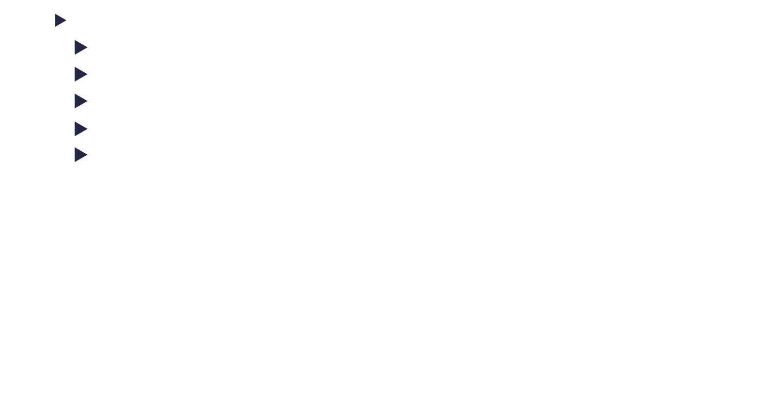




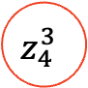

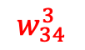


Backpropagation
Some notations:
$w_{ij}^{l}$= the weight from the neuron i from the $l−1$ layer to the neuron $j$ in the $l$ layer
$L$ = the last layer
$y_{i}^{l}$ = the activation of neuron $i$ from the $l$ layer. $y_{i}^{l}=a\left(z_{i}^{l}\right)$; a is activation function
$b_{i}^{l}$ = the bias of neuron $i$ from the $l$ layer
$z_{i}^{l}$= the net input for the neuron $i$ from the $l$ layer ($\sum_{j}{w_{ji}^{l}y_{j}^{l−1}}+b_{i}^{l})$
Layer 2
Layer 3
$$y_{4}^{3}$$
Layer 1
Layer 4
$$z_{4}^{3}$$
$$w_{14}^{3}$$
$$w_{44}^{3}$$
$$w_{24}^{3}$$
$$w_{34}^{3}$$
$$y_{1}^{2}$$
$$y_{2}^{2}$$
$$y_{4}^{2}$$
$$w_{34}^{3}$$
$$y_{3}^{2}$$

Slide 40
Backpropagation
There are 2 main stages in backpropagation:
Forward Step
Backward Step
Forward Step
Layer 2
Layer 3
Layer 1
Layer 4
Backward Step

Slide 41

Backpropagation
Forward step:
Each layer is being processed in sequential order from input -> hidden -> output
Each neuron in the layer computes the weighed sum of the input $z_{i}^{l}$ and the output after applying the activation function $y_{i}^{l}$
The output of one layer is the input for the next layer.
For each layer we store $y_{i}^{l}$. We will need them during backward step
Forward Step
Layer 2
Layer 3
Layer 1
Layer 4

Slide 42
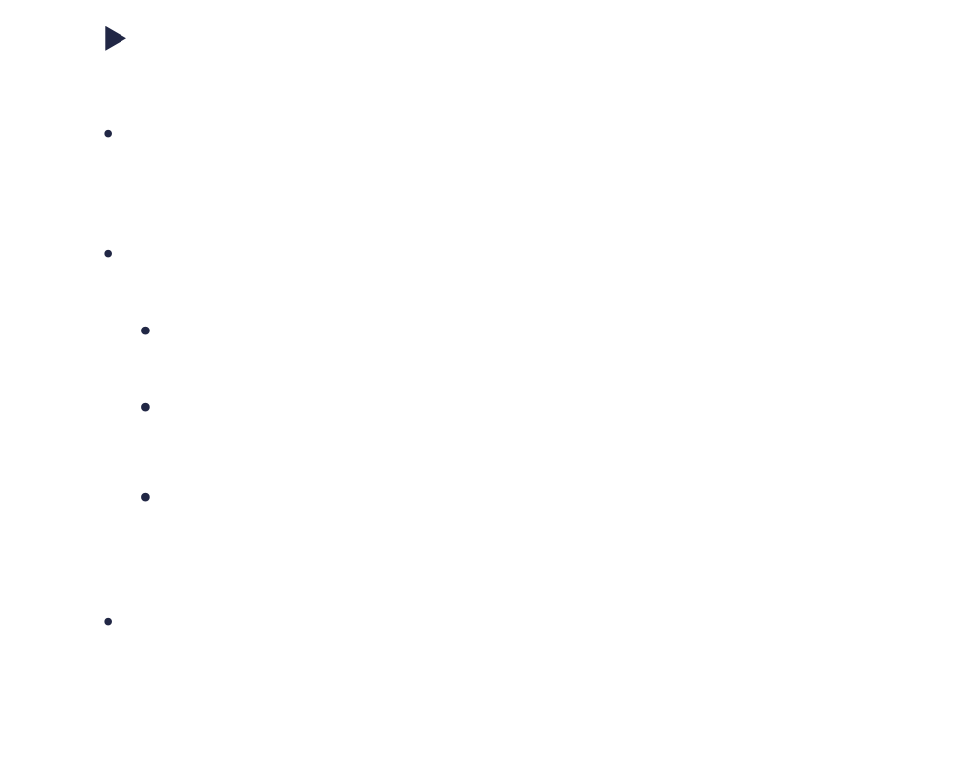
Backpropagation
Backward step:
We first compute the error at the final layer: $δ_{i}^{L}$
We perform the following operations at each layer, from output -> hidden -> input
Propagate the error from current layer $δ_{i}^{l}$ to the layer below
Use the error to compute the gradients for the weights at the current layer $\frac{∂C}{∂w^{l}}$
Update the weights using the computed gradient $w^{l}$
It is important to perform the steps in this order. Do not update weights before propagating the error
Layer 2
Layer 3
Layer 1
Layer 4
Backward Step

Slide 43

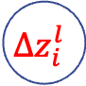




Backpropagation
We will consider that $\frac{∂C}{∂z_{i}^{l}}$ is a measure of the error for the neuron $i$ in the layer $l$
Error for neuron $i$ from layer $l$
$δ_{i}^{l}=\frac{∂C}{∂z_{i}^{l}}$
$δ_{i}^{l}=\frac{∂C}{∂z_{i}^{l}}$
$$δ_{i}^{L}=\frac{∂C}{∂z_{i}^{L}}$$
$$C$$
$$Δz_{i}^{l}$$
Layer 1
Layer 2
Layer 3
Layer 4
Notes:
Putem considera si fata de y, dar prefer asa oentru ca ies calculele mai usoare .
Pana la urma , functia de activare este monotona. N-ar trebui sa fie nicio problema.

Slide 44
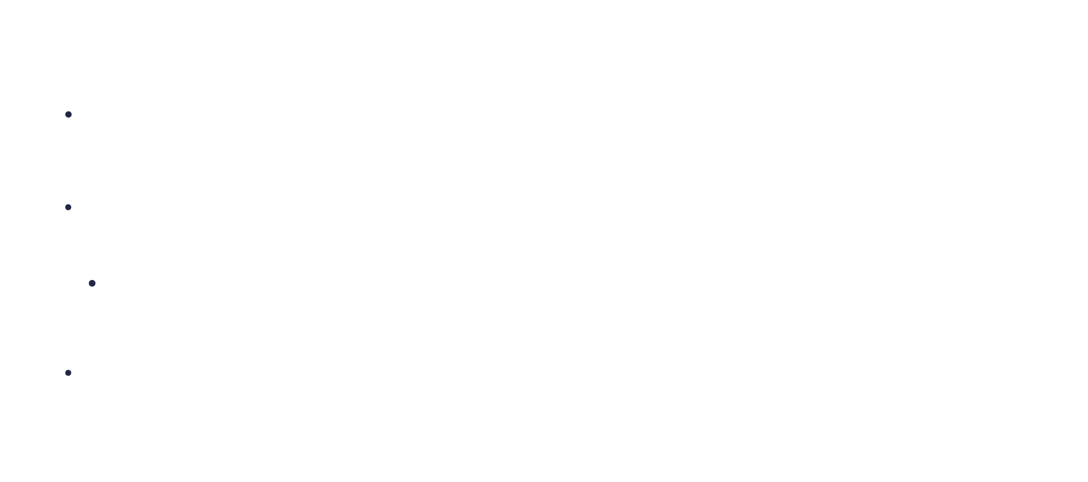
Backpropagation
This makes sense since:
$\frac{∂C}{∂z_{i}^{l}}$ is directly impacted by the weights.
It contains information about the size of error and the direction in which we want to minimize it
If $\left|\frac{∂C}{∂z_{i}^{l}}\right|$ is close to zero, then the cost can not be further reduced
We can derive formulas for backpropagation that are independent of the activation function. The activation function will just be considered $σ(z_{i}^{l})$ and it’s derivative: $σ′(z_{i}^{l})$
Notes:
Putem minimiza functia de cost, prin minimizarea la $ΔC$
- putem face asta alegand un $Δz$ care sa aiba semnul invers la gradient.
- Considerand ca $Δz$ este un numar mic, cum se minimizeaza eroarea depinde de cat de mare este derivate. Mai exact, daca este mare, atunci putem minimiza functia puternic, daca este mica functia nu va fi minizata asa tare, iar daca este zereo, functia nu se mai minimizeaza

Slide 45
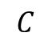
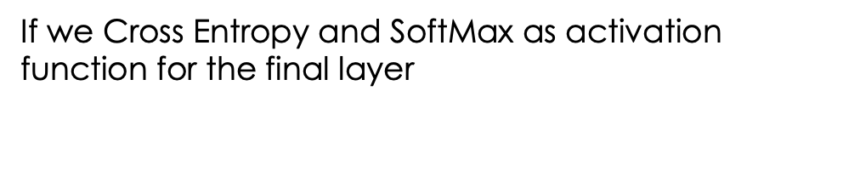
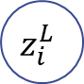


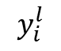
Backpropagation
Compute the error for the final layer:
$$\frac{∂C}{∂z_{i}^{L}}=\frac{∂C}{∂y_{i}^{L}}∙\frac{∂y_{i}^{L}}{∂z_{i}^{L}}=\frac{∂C}{∂y_{i}^{L}}∙a′(z_{i}^{L})$$
Layer L-1
$$δ_{i}^{L}=\frac{∂C}{∂z_{i}^{L}}$$
Last layer
$$z_{i}^{L}$$
$$y_{i}^{l}$$
$$C$$
If we Cross Entropy and SoftMax as activation function for the final layer
$$δ_{i}^{L}=−(t_{i}−y_{i})$$

Slide 46
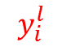
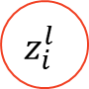





Backpropagation
Backpropagate the error (write the error in respect to the error in the next layer)
$$\frac{∂C}{∂z_{i}^{l}}=\dot{\frac{∂C}{∂y_{i}^{l}}∙\frac{∂y_{i}^{l}}{∂z_{i}^{l}}=\frac{∂y_{i}^{l}}{∂z_{i}^{l}}∙\sum_{k}{\frac{∂C}{∂z_{k}^{l+1}}∙\frac{∂z_{k}^{l+1}}{∂y_{i}^{l}}}=σ^{′}\left(z_{l}^{i}\right)\sum_{k}{δ_{k}^{l+1}∙w_{ik}^{l+1}}}$$
Layer l+1
$$δ_{i}^{l}=\frac{∂C}{∂z_{i}^{l}}=σ^{′}\left(z_{i}^{l}\right)\sum_{k}{w_{ik}^{l+1}⋅δ_{k}^{l+1}}=σ^{′}\left(z_{i}^{l}\right)×(w_{i}^{l+1}⋅δ^{l+1})$$
$$z_{k}^{l+1}$$
$$C$$
$$w_{ik}^{l+1}$$
$$y_{i}^{l}$$
$$z_{i}^{l}$$

Slide 47






Backpropagation
Compute how the cost function depends on a weight
$$\frac{∂C}{∂w_{ki}^{l}}=\dot{\frac{∂C}{∂z_{i}^{l}}∙\frac{∂z_{i}^{l}}{∂w_{ki}^{l}}=δ_{i}^{l}∙y_{k}^{l−1}}$$
Layer 3
Layer 4
$$z_{i}^{l}$$
$$w_{ki}^{l}$$
$$\frac{∂C}{∂w_{ki}^{l}}=δ_{i}^{l}∙y_{k}^{l−1}$$
$$y_{k}^{l−1}$$
$$z_{k}^{l−1}$$

Slide 48





Backpropagation
Compute how the cost function depends on a bias
$$\frac{∂C}{∂b_{i}^{l}}=\dot{\frac{∂C}{∂z_{i}^{l}}∙\frac{∂z_{i}^{l}}{∂b_{i}^{l}}=δ_{i}^{l}∙}$$
Layer 2
Layer 3
Layer 4
$$\frac{∂C}{∂b_{i}^{l}}=δ_{i}^{l}$$
$$z_{i}^{l}$$
$$1$$
$$b_{i}^{l}$$

Slide 49

Backpropagation
Let’s see how this will look in a pseudocode:
We will consider an input x with the following shape (nr_features,1)
We will consider a target t with the following shape (nr_classes, 1)
We will have a list of :
Weight matrixes
weights = [($\left(nr_{features}, {h_{size}}_{0}\right)\left(h_{size0},h_{size1}\right)…(h_{sizen},nr_{classes})$]
Biases:
biases = [${h_{size}}_{0}$, ${h_{size}}_{1},$ …$,$ $h_{sizen},$ $nr_{classes}$]

Slide 50

Backpropagation
Let’s see how this will look in a pseudocode:
Forward pass
Line | Pseudocode
1 | activations = [x]
2 | zs = []
3 | for (w,b) in (weights, biases):
4 | z = w.T $⋅$ activations[-1] +b
5 | zs.append(z)
6 | activations.append(a)
7 | activations[-1]=softmax(zs[-1])

Slide 51

Backpropagation
Backward pass
Line | Pseudocode
1 | error = (activations[-1] - t)
2 | gradient_b[-1] = error
3 | gradient_w[-1] = activations[-2] $⋅$ error.T
4
5 | for l from num_layers-2 to 1:
6 | z = zs[l-1]
7 | sp = sigmoid_prime(z)
8 | error= (self.weights[l] $⋅$ error) * sp
9 | gradient_b[l-1] = error
10 | gradient_w[l-1] = activations[l-1] $⋅$ error.T
1 | function sigmoid_prime(z)
2 | return sigmoid(z)*(1-sigmoid(z))

Slide 52
How to adjust hyper-parameters

Slide 53

How to adjust hyper-parameters
Besides the weights, our network has some parameters that control how it learns:
Learning rate $η$
The mini-batch size
The number of epochs
The number of hidden neurons
All parameters should be tested on a separate dataset (validation set) in order to avoid fitting the parameters to the test set

Slide 54
How to adjust hyper-parameters
The first, and probably the most difficult is to achieve any non-trivial learning. You must obtain results better than you would obtain by a random selection.
In the case of MNIST digits, this means you should obtain something greater than 10%
Start with a smaller dataset. This increases the speed
In the case of MNIST digits this could mean to work with only two numbers (0 and 1)
Start with a smaller network.
In the case of MNIST digits, that could mean to start with a network of 784x10 neurons. (No hidden layer)

Slide 55
How to adjust hyper-parameters
Increase monitoring frequency
Work with just a fraction of the validation set
Monitor the accuracy not only on iterations, but also after you have computed some mini batches (for example, 10 minibatches)
All of the above steps are useful to allow you to receive quick feedback from the network. This allows to test many values for the parameters.
Start by adjusting the learning rate until you see some learning happens.

Slide 56


How to adjust hyper-parameters
You should be increasing or decreasing the learning rate and monitor the cost of the training data. Here is how it looks like for different values of the $η$
For large values of $η$ the gradient descent overshoots
For low variants of $η$ the gradient descent is low

Slide 57
How to adjust hyper-parameters
You should start with a value for the learning rate where the training cost decreases in the first iterations.
Increase it by magnitude (10) until the network starts oscillating. This is the threshold
You can then refine it by slowly increasing it until the costs starts oscillating again (gets close to the threshold). In fact, the value should be a factor, or two below the threshold.

Slide 58
How to adjust hyper-parameters
Choosing the number of iterations is simple: just use early stopping. That means, after each iterations test the network on the validation set. If after x iterations there is no improvement in the classification accuracy, then stop. X can be for example 10 iterations.
At the beginning you should let the network learn for a significant number of iterations in order to avoid the situation where it gets to a plateau only to continue learning again
Notes:
This helps avoid overfitting

Slide 59

How to adjust hyper-parameters
Mini Batch Size:
Mini Batch should be used since we can make use of modern libraries that can compute the weights of all the elements in the batch, at once.
When using larger batches, scale the learning rate in proportion to batch size to maintain stable gradient updates. A rule of thumb is linear scaling:
$$New Learning rate=Learning Rate ×\frac{New Batch Size}{Batch Size}$$

Slide 60
How to adjust hyper-parameters
Common batch sizes:
Small Batch Sizes (8-32):
Useful when data is limited or memory is constrained
Typically enhances generalization but slows down convergence due to noisier gradients
Medium Batch Sizes (32 - 256):
Popular choice as it balances training stability, speed, and generalization.
Works well on most standard tasks and networks
Often a good starting point; adjustments can then be made based on validation performance.
Large Batch Sizes (512 or more):
Effective when training time is a high priority, and computational resources are abundant.
Often beneficial for massive datasets,

Slide 61
How to adjust hyper-parameters
Mini Batch Size:
Start with a batch size that should fit in the GPU, example 32 or 64
Monitor validation accuracy against time (real time, not number of epochs) and .
Double the batch size and monitor validation accuracy. Doubling in batch size should translate in (almost) doubling the training speed. Time per step should be almost the same if the memory of the GPU hasn’t saturated.
Stop when increasing the batch size is detrimental.

Slide 62
Questions & Discussion

Slide 63
Bibliography
http://neuralnetworksanddeeplearning.com/
Chris Bishop, “Neural Network for Pattern Recognition”
http://sebastianraschka.com/Articles/2015_singlelayer_neurons.html
http://deeplearning.net/
https://www.pinecone.io/learn/weight-initialization/

